Slide 1
Term deposit prediction
Dănănău Ștefan-Răzvan
Ivasișin Andrei Marian
Data Science, 511

Slide 2
Introduction
The dataset describes different information about the observed people, like typical client data as education, age; but also the history with the previous marketing campaigns or with the actual one.
It also looks at different social and economic attributes, like euribor or the consumer price index.
The scope is to predict wether or not a client will subscribe to a term deposit based on the features.

Slide 3
EXPLORATORY DATA ANALysis
After importing the necessary libraries and creating a dataframe, we moved forward with preprocessing data for the models:
Searching for null and duplicates values and remove them;
Remove columns that would otherwise influence the model: pdays (almost all values were the same) and duration (discarded at the recommendation of the authors if we want to have a realistic predictive model);
Classify 3 levels from the education column into a single one (basic.9y, basic.6y and basic.4y into Basic).

Slide 4
EXPLORATORY DATA ANALysis
Some other commands pointed out to the fact that:
There is a big majority of object type columns;
The data is unbalanced as we have 36537 cases where no term deposit was established and only 4639 where it was succeded.

Slide 5
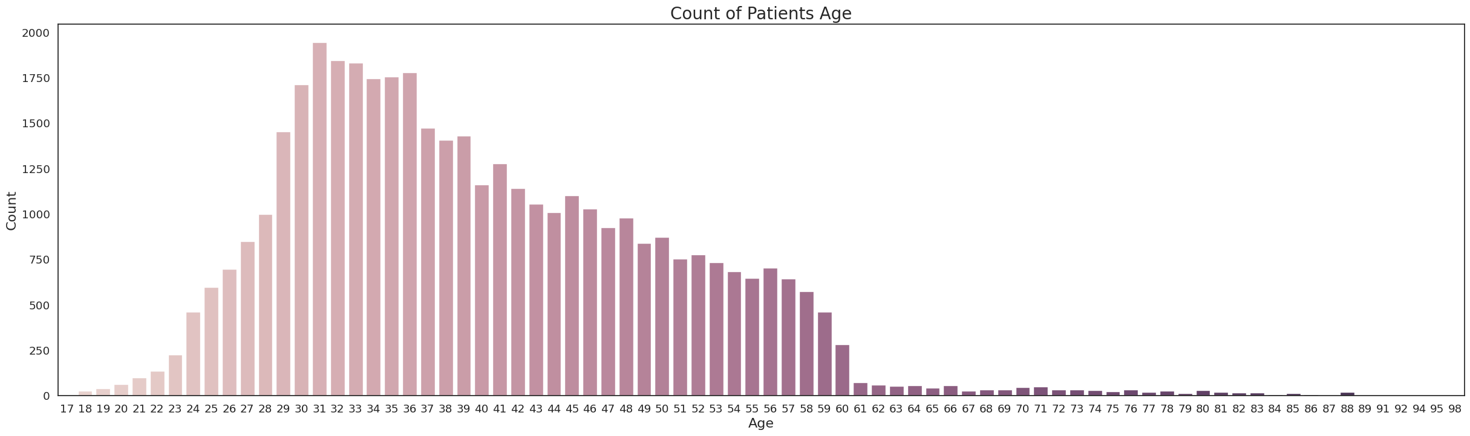
DATA visualization
The plot above suggests that the vast majority of the clients are ranged between 29 and 39 years.

Slide 6
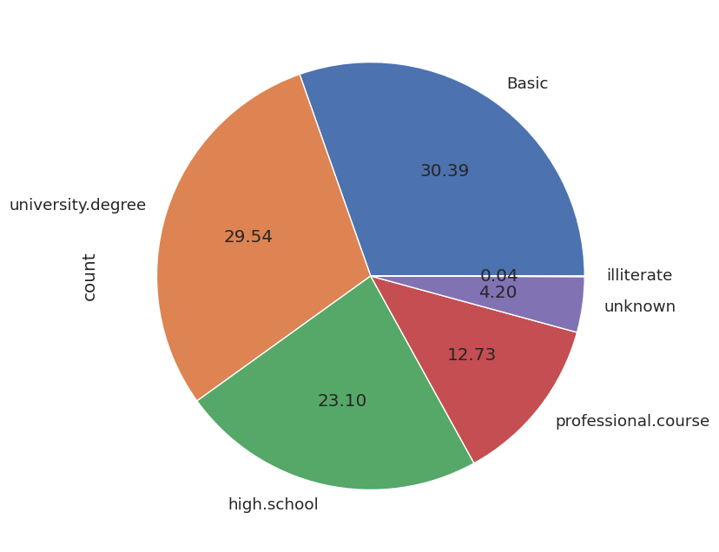
DATA visualization
By combining the basic education categories it seems like most of the clients were only people with not so many studies, but before putting them together the clients with an university graduated were first.

Slide 7
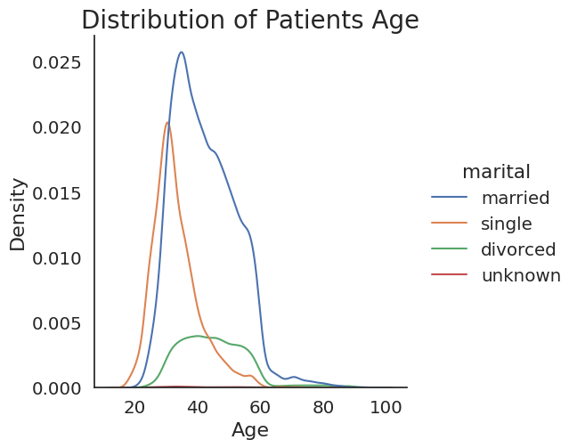
Data visualization
The split of the population seems like hits the biggest density point somewhere between 30-40 years, while married people being the most present, then single and then divorced.

Slide 8
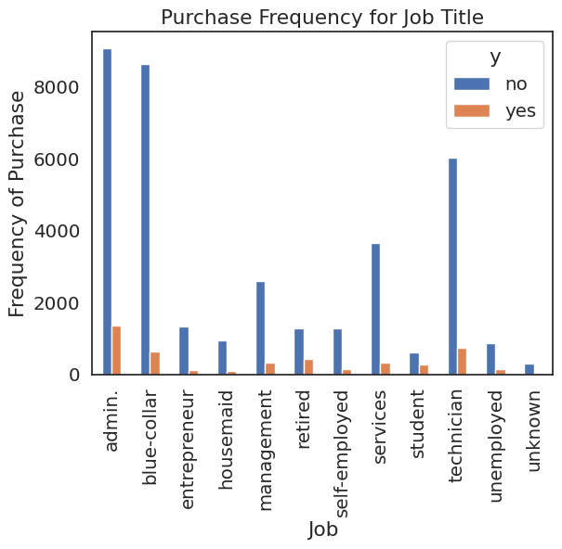
Data visualization
By looking at this graph there can be concluded that depending on the job title there can be expected to have different responses for the term deposit. This means it is a good predictor for the outcome.

Slide 9
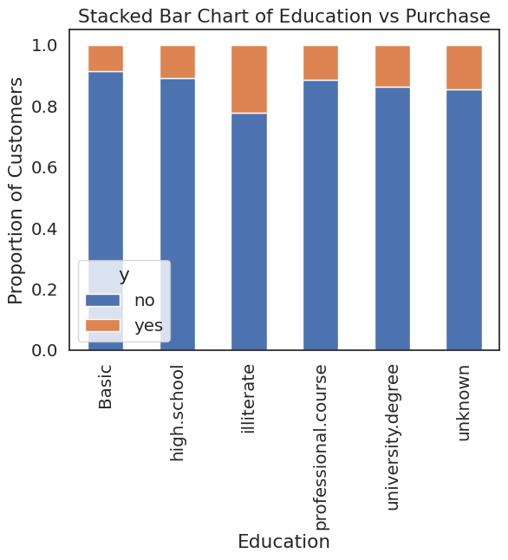
Data visualization
Education seems to also be a strong predictor for the outcome, since it shows variations based on each education level.

Slide 10
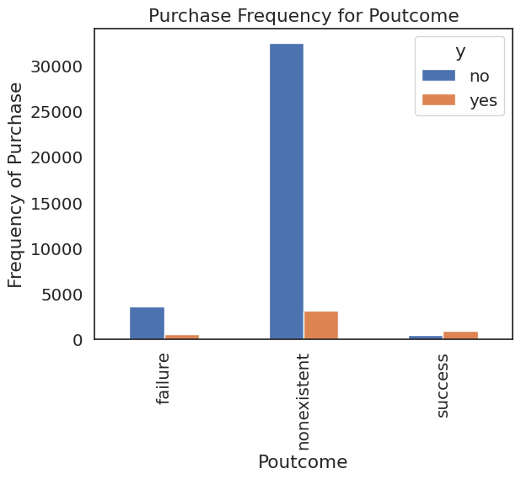
Data visualization
Seems also like the outcome from the previous campaign is in strong relationship to subscribing to a term deposit or not:
When it was nonexistent or failure, most of the responses would be no;
When it was a success it seems like the outcome would rather be yes.

Slide 11
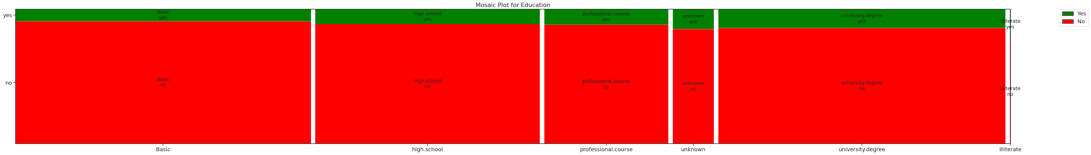
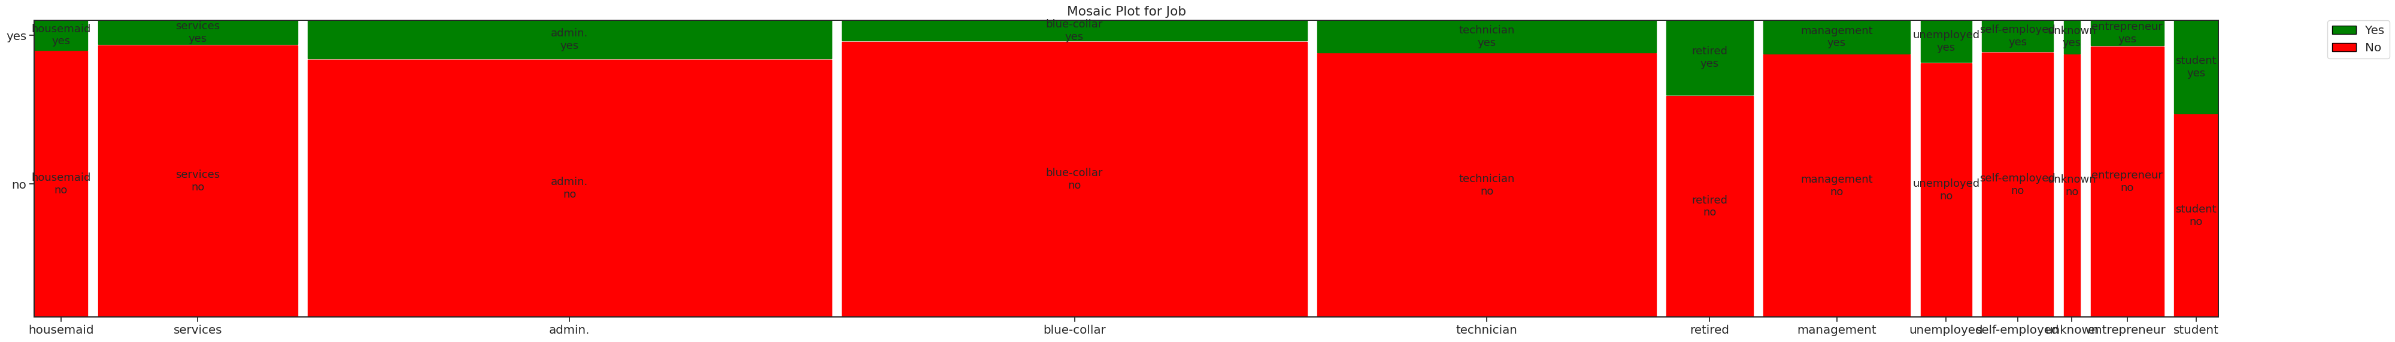
Data visualization
Based on these mosaic plots, seems that those who have completed a university degree and are either retired or students are more likely to place a term deposit.

Slide 12
Machine learning models
In order for our data to work in the context of a machine learning model we did the following:
Encode the categorical variables with the help of get_dummies;
Split the data into X and y, and also convert y to numerical values.

Slide 13
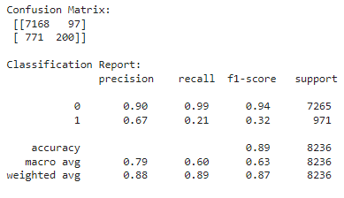
Logistic Regression
We split data with train_test_split and then used the StandardScaler for scaling our data.
The accuracy obtained on the test data and the confusion matrix plus the classification report can be obtained here:
The accuracy on test data is pretty big,
while precision and recall suggests a very
good classification for outcome 0, while for 1
it is not so good at least for recall.

Slide 14
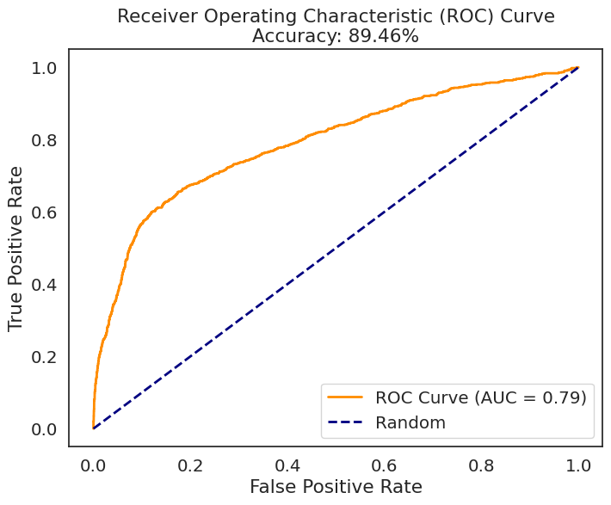
Logistic regression
The plot of the ROC curve can be observed here, and it suggests that the model is doing a great job distinguishing between the two possible outcomes we have; also suggested by the AUC value of 0.79.

Slide 15
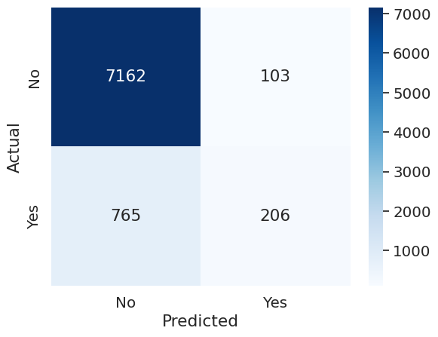
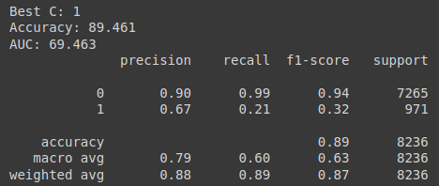
SVC
A grid search for C parameter was done, using cross validation too, the highest accuracy of 89% was recorded for C=1. Unfortunately, AUC was only 69%, due to the minority class achieving only 21% accuracy.

Slide 16
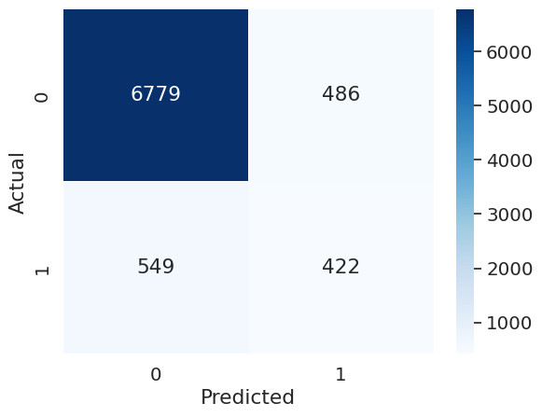
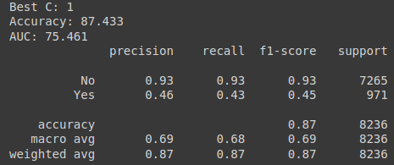
SVC + SMOTE
SMOTE oversampling technique was used for minority class. The AUC increased to 75%, the minority class improving to 43% accuracy, while class '0' dropped to 93% accuracy now, from its previous value of 99%.

Slide 17
conclusion
The application of machine learning results bring pretty good results, with a minimum of effort.
Further research can be done in order to see how applying bagging/boosting algorithms can influence the final results, or who knows, maybe even deep learning algorithms.

